Slide 1
PYTHON
Lecture - 08
Lecture Topics
String

Slide 2

Python - String Manipulation (RECAP)
Declaration of a string
Single Quotes
>>> spam = 'Say hi to Bob\'s mother.'
Double Quotes
>>> spam = "That is Alice's cat."
Triple Quotes
print('''Dear Alice,
Eve's cat has been arrested for catnapping, cat burglary, and extortion.
Sincerely,
Bob''')

Slide 3
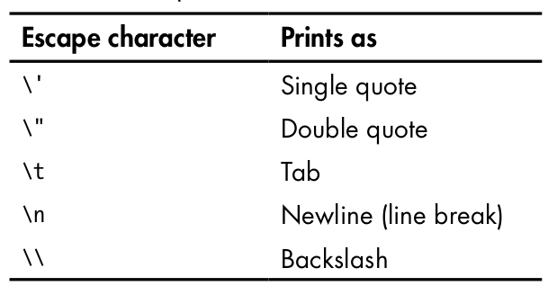
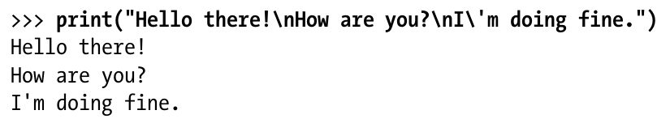
Python - String Manipulation (RECAP)
Escape Characters in string

Slide 4
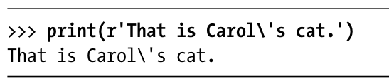
Python - String Manipulation (RECAP)
Raw Strings
Place an r before the beginning quotation mark of a string to make it a raw string.
A raw string completely ignores all escape characters and prints any backslash that appears in the string.

Slide 5
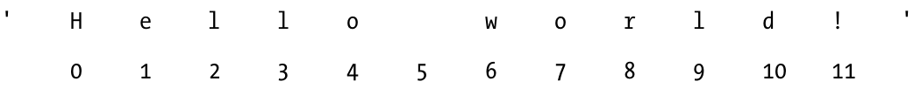
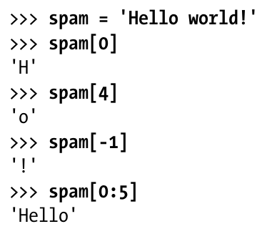
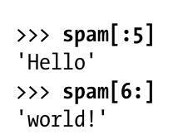
Python - String Manipulation
Indexing and Slicing Strings
Think of the string 'Hello world!' as a list and each character in the string as an item with a corresponding index.
-12 -11 -10 -9 -8 -7 -6 -5 -4 -3 -2 -1

Slide 6
Python - String Manipulation (Theory Recap)
Indexing and Slicing Strings
str = “ a b c d e f ”
Index→ 0 1 2 3 4 5
str[ start : end ] → return substring of str from index start to end-1.
str[ : idx ] → return substring of str from beginning to index idx-1.
str[ idx : ] → return substring of str from index idx to end of the string.

Slide 7
Python - String Manipulation (Theory Recap)
Indexing and Slicing Strings
str = “ a b c d e f”
Index→ 0 1 2 3 4 5
print( str[2:4] ) # ‘cd’
print( str[1:] ) # ‘abcdef’
print( str[:3] ) # ‘abc’

Slide 8
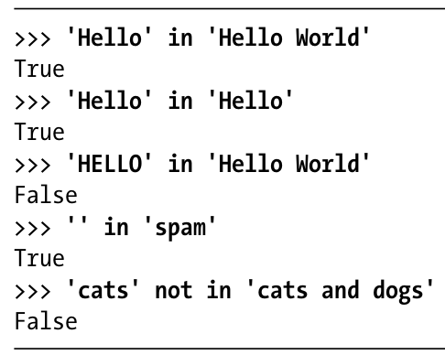
Python - String Manipulation
The in and not in Operators with Strings
The in and not in operators can be used with strings just like with list values. An expression with two strings joined using in or not in will evaluate to a Boolean True or False.

Slide 9
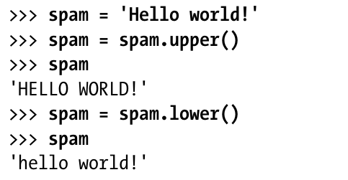
Python - String Manipulation
The upper(), lower() String Methods
The upper() and lower() string methods return a new string where all the letters in the original string have been converted to uppercase or lower- case, respectively.
Non-letter characters in the string remain unchanged.

Slide 10
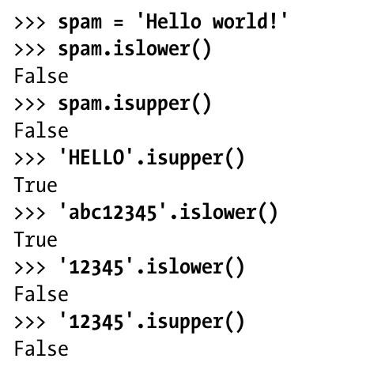
Python - String Manipulation
The isupper(), islower() String Methods
The isupper() and islower() methods will return a Boolean True value if the string has at least one letter and all the letters are uppercase or lowercase, respectively. Otherwise, the method returns False.

Slide 11
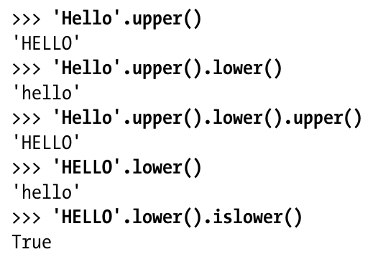
Python - String Manipulation
Exercise – 01

Slide 12
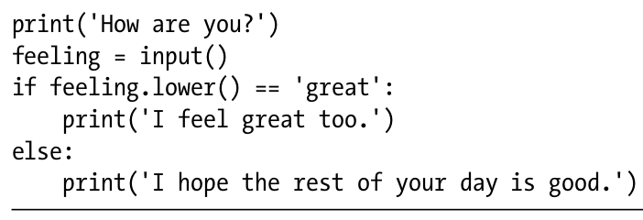
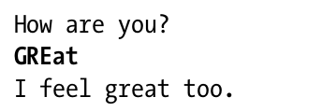
Python - String Manipulation
Exercise – 02

Slide 13
Python - String Manipulation
The isX String Methods
isalpha() → returns True if the string consists only of letters and is
not blank.
isalnum() → returns True if the string consists only of letters and
numbers and is not blank.
isdecimal() → returns True if the string consists only of numeric
characters and is not blank.
isspace() → returns True if the string consists only of spaces, tabs,
and new- lines and is not blank.
istitle() → returns True if the string consists only of words that begin
with an uppercase letter followed by only lowercase
letters.

Slide 14
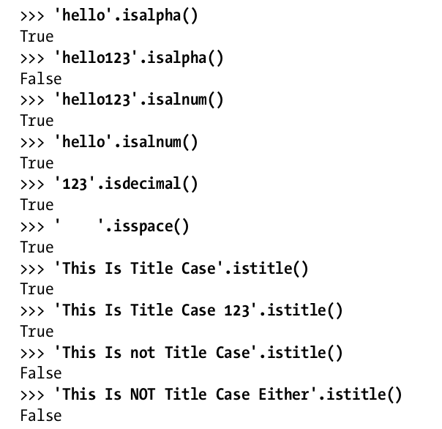
Python - String Manipulation
The isX String Methods

Slide 15
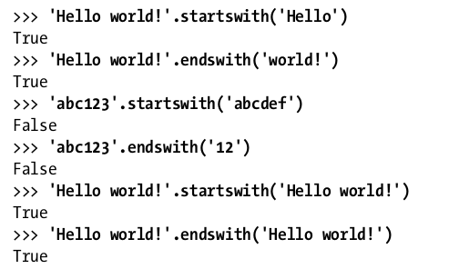
Python - String Manipulation
The startswith() and endswith() String Methods
The startswith() and endswith() methods return True if the string value they are called on begins or ends (respectively) with the string passed to the method; otherwise, they return False.

Slide 16
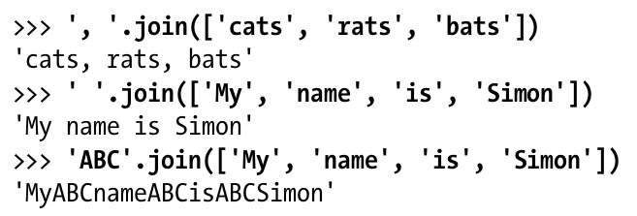
Python - String Manipulation
The join() String Methods
The join() method is useful when you have a list of strings that need to be joined together into a single string value.
The join() method is called on a string, gets passed a list of strings, and returns a string.
The returned string is the concatenation of each string in the passed-in list.

Slide 17

Python - String Manipulation
The split() String Methods
The split() method does the opposite.
It’s called on a string value and returns a list of strings.
By default, the string 'My name is Simon' is split wherever whitespace- characters such as the space, tab, or newline characters are found.

Slide 18
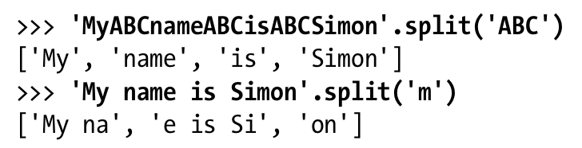
Python - String Manipulation
The split() String Methods
You can pass a delimiter string to the split() method to specify a different string to split upon.

Slide 19
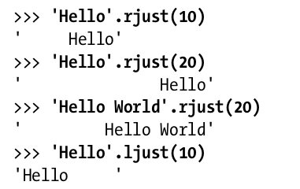
Python - String Manipulation
Justifying Text with rjust(), ljust(), and center()
The rjust() and ljust() string methods return a padded version of the string they are called on, with spaces inserted to justify the text.
The first argument to both methods is an integer length for the justified string.

Slide 20
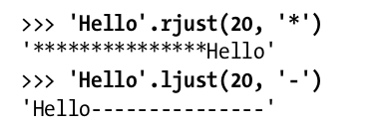
Python - String Manipulation
Justifying Text with rjust(), ljust(), and center()
An optional second argument to rjust() and ljust() will specify a fill character other than a space character.

Slide 21
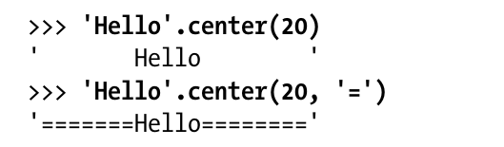
Python - String Manipulation
Justifying Text with rjust(), ljust(), and center()
The center() string method works like ljust() and rjust() but centers the text rather than justifying it to the left or right.

Slide 22
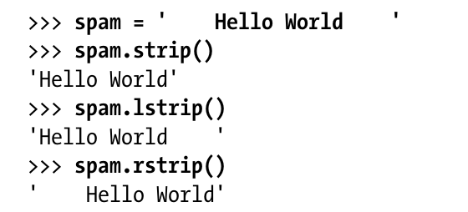
Python - String Manipulation
Removing Whitespace with strip(), rstrip(), and lstrip()
The strip() string method will return a new string without any whitespace characters at the beginning or end.
The lstrip() and rstrip() methods will remove whitespace characters from the left and right ends, respectively.

Slide 23
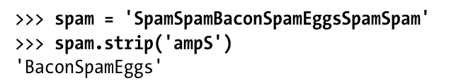
Python - String Manipulation
Removing Whitespace with strip(), rstrip(), and lstrip()
Optionally, a string argument will specify which characters on the ends should be stripped.

Slide 24

Exercise Time

Slide 25
Problems (1)
Checks if two strings are anagrams of each other. Anagrams are words or phrases that contain the same characters but in different orders (i.e., listen and silent)
Checks if a given string is a palindrome. A palindrome is a word, phrase, or sequence that reads the same backward as forward (i.e., , madam, racecar).
Checks if a string contains only digits (0-9).
Count the number of occurrences of each word in a string
Sample Input: Python is an easy. Love Python
Sample Output: Python:2, is: 1, an: 1, easy: 1, Love:1

Slide 26
Problems (2)
Create a menu consisting the following:
1. Add
2. View All
3. Edit
4. Search
5. Delete
6. Exit
Enter your choice:

Slide 27
Exercise – 7.1
Create a function that takes a list of int numbers as a parameter and returns its sum.

Slide 28
Exercise – 7.1 (ans)
def findSum(x):
sum = 0
for i in x:
sum+=i
return sum
List = [2,3,7,10]
print(findSum(List))

Slide 29
Exercise – 7.2
Create a function that takes two of int numbers as a parameter and returns thair GCD.

Slide 30
Exercise – 7.2 (ans)
def GCD(x,y):
n = min(x,y)
gcd = 0
for i in range(1,n+1):
if x%i == 0 and y%i == 0:
gcd = i
return gcd
ans = GCD(8,12)
print(ans)

Slide 31
Exercise – 7.3
Build a module called myString.py that contain the following functions (each of them takes a string as parameter) —
vowelCount() → returns the count of vowel in the string.
uniqueChar() → returns the count of unique char of the string.
And then import and call the functions from another python file.
For Example:
vowelCount(“school”) → return 2, as there are 2 vowels.
uniqueChar(“exercise”) → return 6, as there are 6 unique char.

Slide 32
Exercise – 7.3 (ans)
#save file as myString.py
def vowelCount(str):
cnt = 0
for ch in str:
if(ch=='a' or ch=='e' or ch=='i' or ch=='o' or ch=='u'):
cnt+=1
return cnt
def uniqueChar(str):
List = []
for i in range(26):
List.append(0)
for ch in str:
idx = int(ord(ch)) - int(ord('a'))
List[idx]=1
cnt = 0
for i in List:
if(i>0):
cnt+=1
return cnt

Slide 33
Exercise – 7.3 (ans cont.)
#In another python file, write the code and run
import myString
print(myString.vowelCount("school"))
print(myString.uniqueChar("exercise"))

Slide 34
Resources
https://www.tutorialspoint.com/python/index.htm
https://www.w3resource.com/python/python-tutorial.php
https://www.w3resource.com/python-exercises/string/
https://www.w3schools.com/python/
https://www.geeksforgeeks.org/python-programming-language/
https://youtu.be/t2_Q2BRzeEE?si=OO6J_YNCZykedqsT
https://realpython.com/
Head First Python, 3rd Edition by Paul Barry
Automate the Boring Stuff with Python By Al Sweigart.

Slide 35

Thank You

